Slide 1

Automated Essay Grading

Slide 2
Introduction
Team: David Llerena, Ailany Rodriguez, Amani Hunt, Timothy King, Michael Wei, Matias Fuenzalida, Malcolm Verdier, Jalen Williams
Product Owner: David Gray
Instructor: Dr. Masoud Sadjadi

Slide 3



Problem with manual essay grading
Tedious Costly Time-Consuming

Slide 4
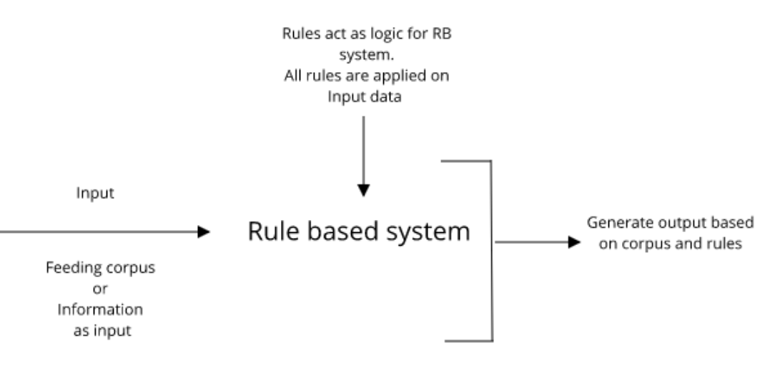
Approach
Diagram provided by packthub.com

Slide 5
Current System
StudyBuddy Pro
Case briefs
Lessons
Outlines
Courses
Quizzes
Workshops
Charts and notes

Slide 6
Requirements
Automated grading system for grading student responses and giving feedback
Section for teacher to create rulebooks

Slide 7
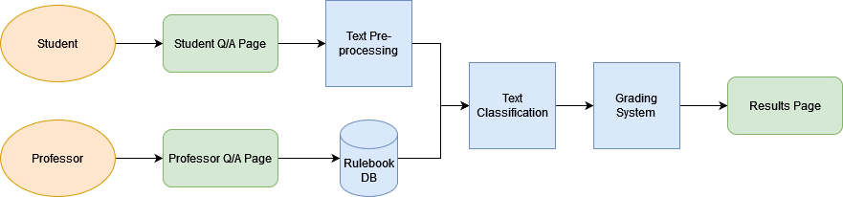
System Design
FLORIDA FLORIDA lkjlkj

Slide 8
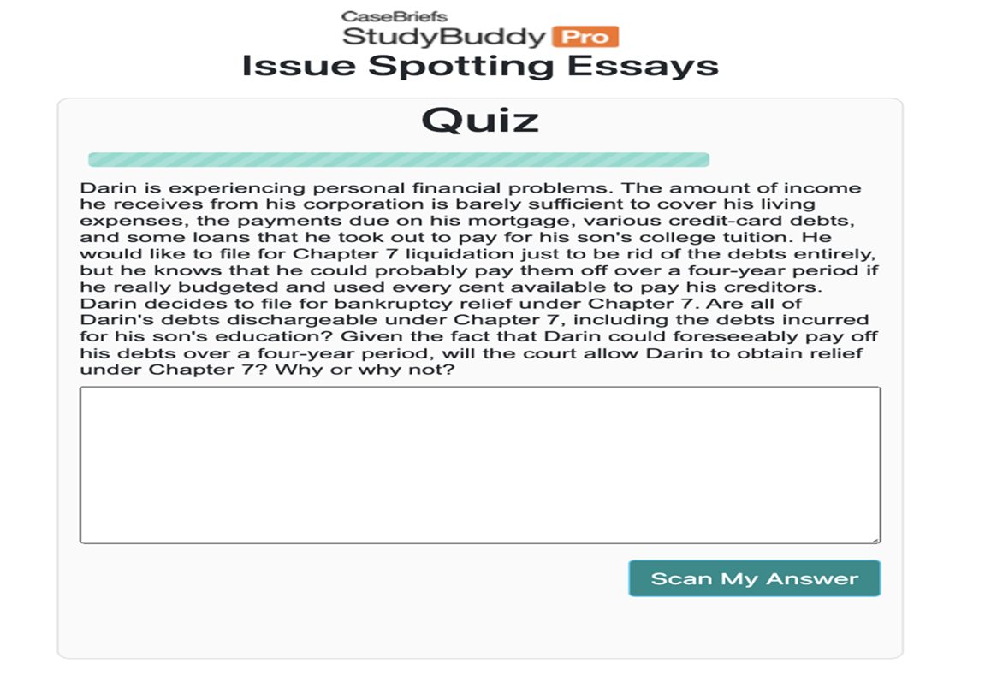
Object Design

Slide 9




Implementation

Slide 10
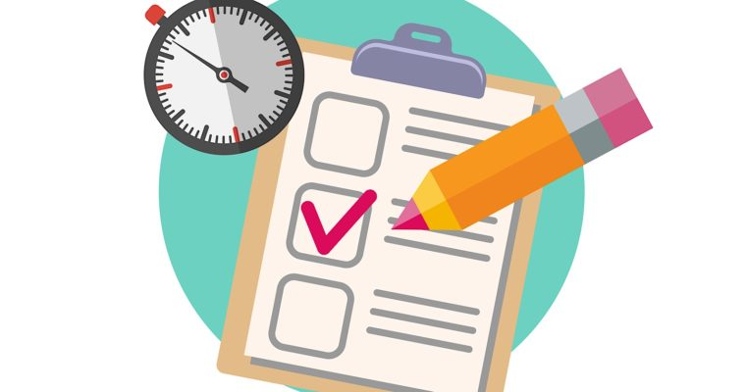
Verification
Tested sytem manually to verify accuracy
Label parts of student response: pass
Grammar check: pass

Slide 11

Summary
Help law students succeed by providing them practice essay questions
Give students scores and feedback based on how well they answer questions

